Slide 1
Sociogram Web Application
Code 6

Slide 2
Project Description
Sociogram is a web application which runs on the web server where users can make use of the following features :
Create Account
Connect with friends/family
Upload shared media
Access to Discussion forums

Slide 3
Team Member’s & Responsibilities
Team Members | Responsibilities
1) Sathwik Gaddi | Posts, Discussions, Friends Modules (Frontend and Backend Api’s)
2) Tanvi Thirunathan | Posts Module (Backend)
3) Satish Thammaneni | User Profile (Backend)
4) Sai Karthik Koncherlakota | UI Screens
5) Venkata Rajashekhar Chinthala | UI Screens
6) Sri Snigdha Kotharu | Discussions Module(UI Design)
7) Raja Srinivas Nelluri | Discussions Module(Backend)
8) Putta Ramya Priya | Discussions Module(UI Design)

Slide 4
Requirements
Signup :
REQ1 : Signup Page
REQ2: Username and password fields
REQ3: Confirm Password
REQ4: Dropdown to select two “interests”.
REQ5: User authentication operation (To Validate Credentials)
REQ6: Register (Registered upon successful Validation)

Slide 5
Requirements (Cnt.)
Login :
REQ1: Login Page
REQ2: Username and password fields
REQ3: User authentication operation (To Validate Login Credentials)
REQ4: Redirect to Home Page (Upon successful Validation)

Slide 6
Requirements (Cnt.)
Upload Media
REQ1: Form with fields (tagline, upload post, privacy [private, public] )
REQ2: Image that meets Layout criteria (To upload)
REQ3: upload Button (To display the media content on user’s page)

Slide 7
Requirements (Cnt.)
Find Friends
REQ1: List View (To display friends with similar interests)
REQ2: Add Friends Button (To add a particular User to friends list)
REQ3: Remove Friends Button (To remove a particular User to friends list)

Slide 8
Requirements (Cnt.)
Discussion Forum
REQ1: Create Discussion Button (To create new discussions)
REQ2: Forum (Question title and Question Description)
REQ3: Upvote / Downvote (Users can poll for answers that are relevant to question)
REQ4: My discussion page (To view all the uploaded discussions)

Slide 9
Implementation
UI Design and Development
UI Design :
HTML, CSS, Bootstrap, JavaScript.
Front End Framework:
Angular
Platform :
Visual Studio Code

Slide 10
Implementation (Cnt.)
Backend Development
Languages :
NodeJs
Platform :
Visual Studio Code
Middleware :
Express.js

Slide 11
Implementation (Cnt.)
Database :
MongoDB
Project Management Tool
Trello
Configuration Management System
GitHub
Overall Structure
Full stack Web application with fully functional CRUD operations

Slide 12
Hardware Configurations
Windows Requirements :
Operating System : windows 8 or later
Processor : Intel Pentium 4 or later
Memory : 2GB or greater
Screen Resolution : 1280*1024 or larger
Internet connection : Required

Slide 13
Hardware Configurations (Cnt.)
Mac Requirements :
Operating System : macOS Sierra 10.12 or later
Processor : Intel
Memory : 2GB or greater
Screen Resolution : 1280*1024 or larger
Internet connection : Required

Slide 14
Hardware Configurations (Cnt.)
Linux Requirements :
Operating System : 64-bit Ubuntu 14.04+, Debian 8+, openSUSE 13.3+, or Fedora Linux 24+
Processor : Intel Pentium 4 or later
Memory : 2GB or greater
Screen Resolution : 1280*1024 or larger
Internet connection : Required

Slide 15
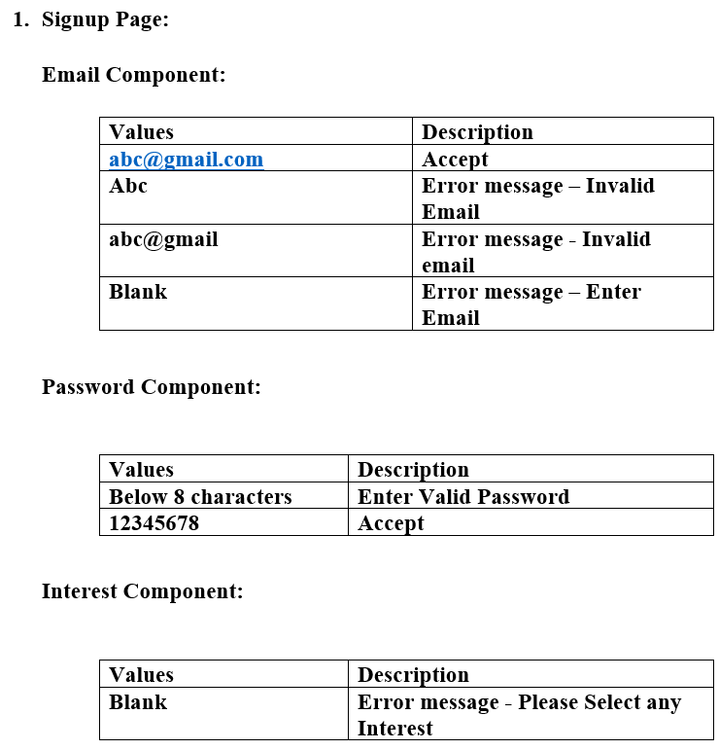
Testing (Unit)

Slide 16
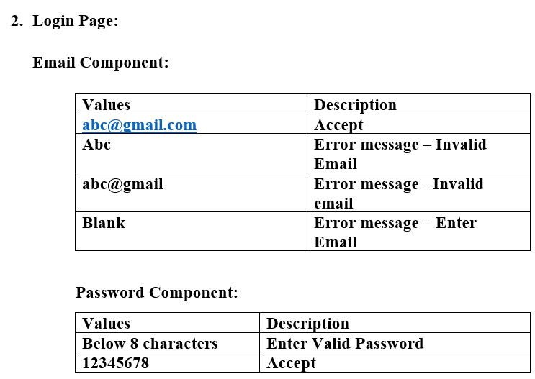
Testing (Unit) – Cnt.

Slide 17
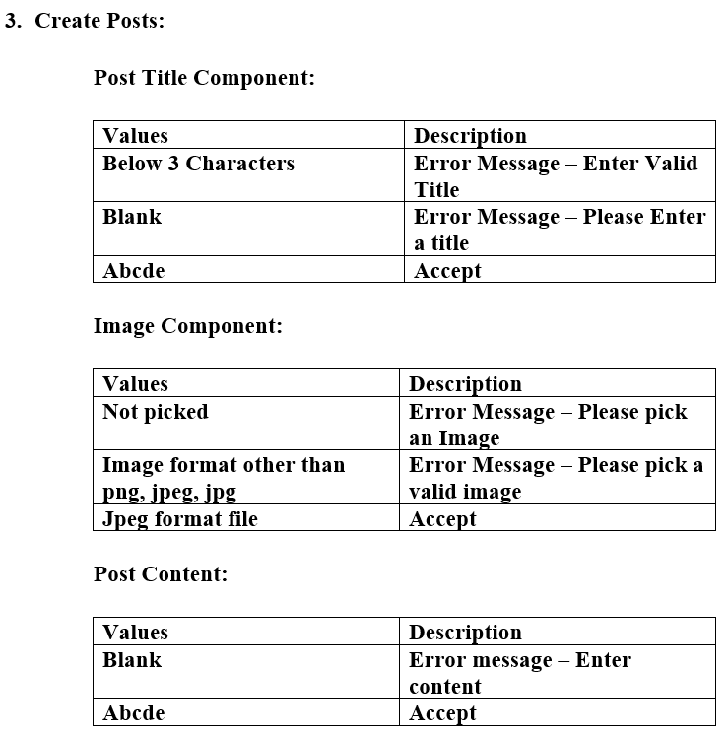
Testing (Unit) – Cnt.

Slide 18
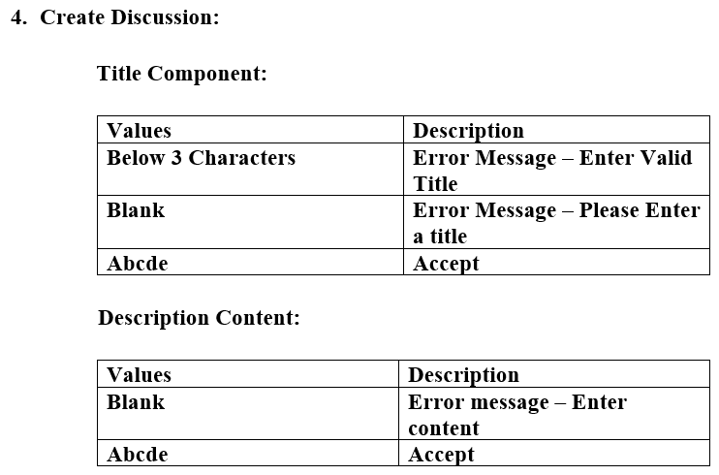
Testing (Unit) – Cnt.

Slide 19
Testing (Functional) – Cnt.
Signup Page
Description: A user should be able to successfully register for the application.
Precondition: the user must not already be registered with this email address and username. Assumption: a supported browser is being used.
Test Steps:
Navigate to Signup Page.
Enter all the details in the form provided.
Click ‘Sign up’
Expected Result: User must be successfully registered and redirected to the home page.

Slide 20
Testing (Functional) – Cnt.
Login Page
Description: A user should be able to successfully login to the application.
Precondition: the user must already be registered with this email address and username.
Assumption: a supported browser is being used.
Test Steps:
Navigate to Login Page.
Enter all the details in the form provided.
Click ‘Login’
Expected Result: User must be successfully able to login and redirected to the home page after login.

Slide 21
Testing (Functional) – Cnt.
Find Friends Page
Description: A user should be able to view all the people who have similar interests.
Precondition: the user should provide his/her interests at the time of registration and be logged in to access this feature.
Assumption: a supported browser is being used.
Test Steps:
Navigate to Find Friends Page.
Expected Result: User must be successfully able to view all the list of people with similar interests.

Slide 22
Testing (Functional) – Cnt.
New Post Page
Description: A user should be able to successfully upload a new post.
Precondition: the user must be logged in to access this feature.
Assumption: a supported browser is being used.
Test Steps:
Navigate to New Post Page.
Enter all the details in the form provided.
Click ‘Add’
Expected Result: User must be able to successfully upload the post and redirected to home page.

Slide 23
Testing (Functional) – Cnt.
Posts Page
Description: A user should be able to successfully view the posts.
Precondition: the user must be logged in to access this feature.
Assumption: a supported browser is being used.
Test Steps:
Navigate to Posts Page.
Expected Result: User must be successfully able to view all the posts.

Slide 24
Testing (Functional) – Cnt.
Discussion forum – All Discussions
Description: A user should be able to view all discussions.
Precondition: A discussion is to be posted for user to view them.
Assumption: A discussion is already created, and supported browser is being used.
Test Steps:
Navigate to Discussions on the Top Navbar.
Click on “All Discussions”.
Expected Result: User must be successfully able to view all the discussions.

Slide 25
Testing (Functional) – Cnt.
Discussion forum – My Discussions
Description: A user should be able to view his/her discussions that are created, and answers received for it.
Precondition: A discussion should be created by user to view them.
Assumption: A user has created a discussion and supported browser is being used.
Test Steps:
Navigate to Discussions.
Click on “My Discussions”.
Expected Result: User must be successfully able to view all the discussions created by him/her, number of answers and those answers that are posted by others.

Slide 26
Testing (Functional) – Cnt.
Discussion forum – Create New Discussion
Description: A user must be able to successfully create a new discussion.
Precondition: The user must be logged in to access this feature.
Assumption: A supported browser is being used.
Test Steps:
Navigate to Discussions.
Click on “Create New Discussion”.
Type “Question Title”.
Type “Question Description”.
Click on “Create Discussion”.
Expected Result: User must be successfully able to create a new discussion.

Slide 27
Testing (Functional) – Cnt.
Discussion forum – Delete Discussion
Description: A user must be able to successfully delete a discussion form created by him/her.
Precondition: The user must be logged in to access this feature.
Assumption: A discussion which was already created by the user and supported browser is being used.
Test Steps:
Navigate to Discussions.
Click on “My Discussion”.
Click on a Discussion that is created previously and user wants to delete.
Click on “Delete”.
Expected Result: User must be successfully able to delete a discussion form created previously and view message “No Discussions Posted Yet!!” if the one which is deleted is the only discussion existing.

Slide 28
Testing (Functional) – Cnt.
Change Password
Description: A user must be able to successfully change his/her password.
Precondition: The user must be logged in to access this feature.
Assumption: A user is willing to change his/her password but, still knows his old password.
Test Steps:
Navigate to “Change password”.
Type “Current Password”.
Type “New Password”.
Type same password “Confirm New Password”.
Click on “Change Password”.
Expected Result: User must be successfully able to change his/her password.

Slide 29
Feedback from Peer Reviews
Partner Group Name – SOUL_CYNICS
Feedback 1 : Change password option
We have accepted this suggestion by partner team and have implemented the above feature in phase 3. The feature is thoroughly tested as well.
Feedback 2: Access of discussion forum to only selected people
We have rejected this suggestion by partner team because the main purpose of discussion forum is to get public opinion.

Slide 30
Code inspection results
Partner Group Name – SOUL_CYNICS
Feedback 1 : Code Formatting
We agree to the above point as practicing to remove the commented part of the source code file helps remove the blockers while doing the code inspection and while debugging the errors if any.
We have further stored the sub version of the code using the version control systems like Git. By doing this, we will be able to retrieve the commented section if required any further in the project implementation.

Slide 31
Limitations
Knowledge constraints [Technologies]
Time constraints
Lack of communication [Team Building]

Slide 32


